Slide 1

GROUP 6-
PGAGENT TOOLS ENHANCEMENT
IN COLLABORATION WITH IITM PRAVARTAK
BRIAN CHRISTOPHER R6B-30
JOEL DANIEL PRADEEP R6B-42

Slide 2

WHAT IS PGAGENT?
pgAgent is an open-source job scheduling agent for PostgreSQL. It automates database tasks like backups, maintenance, and reports.
Scheduling and automation are critical for database management and system maintenance.

Slide 3
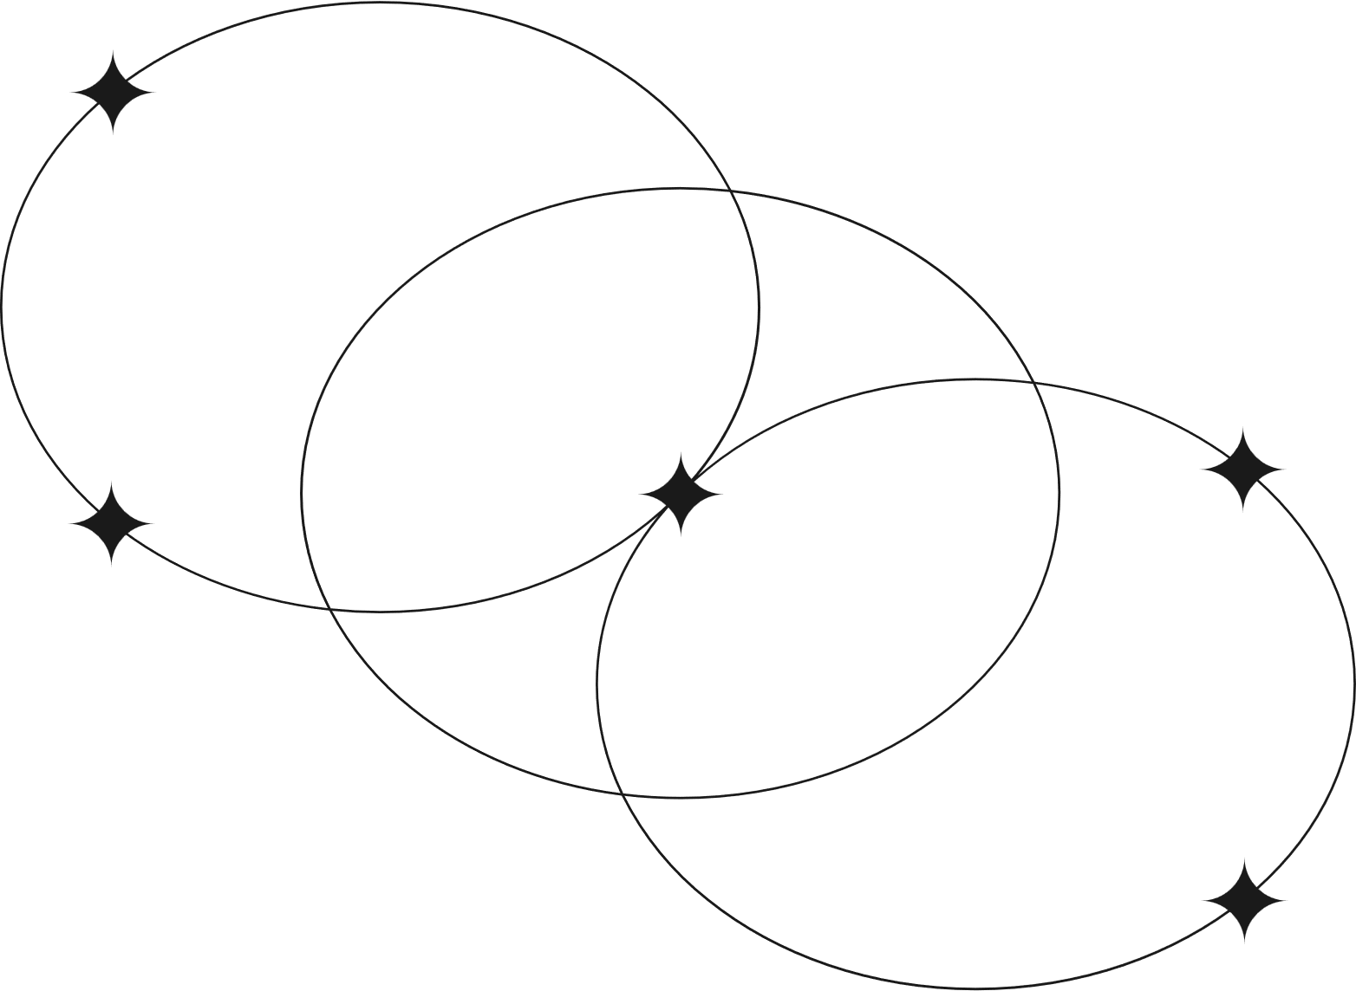
Job Management Enhancements
Features selected
36.2 Job Dependencies
Security and User Management
Allows defining relationships between jobs to ensure execution order. For example, Job B will only start after Job A is successfully completed, which is crucial for workflows where tasks rely on the outputs of preceding jobs.
38.1. Role-Based Access Control
RBAC ensures that users have permissions tailored to their roles, enabling fine-grained control over job management. For example, administrators can have full control, while standard users may only view or execute jobs. This enhances security and reduces the risk of unauthorized actions.

Slide 4
Existing Problems In Job Dependency
Current Scenario : Jobs in pgAgent are managed independently without dependencies.
Associated problems:
Lack of Visibility and Monitoring : makes it difficult to troubleshoot or optimize workflows.
Dependency Failure Handling : When a job in a dependency chain fails, it can halt the entire workflow without providing options for retry or skipping failed jobs.
Scalability Issues : As the number of jobs and dependencies grows, the system may struggle to handle the complexity, leading to performance degradation.

Slide 5
Existing Solutions/Approaches
Job Dependencies:
Apache Airflow : Apache Airflow is a workflow automation platform that supports defining complex job dependencies using Directed Acyclic Graphs (DAGs).
SQL Server Agent : Microsoft SQL Server Agent provides job scheduling and supports job dependency management through step conditions. You can configure jobs to start based on the success, failure, or completion of other jobs.

Slide 6
Functional Requirements
• FR-1: Support sequential and conditional job execution.
• FR-2: Allow parallel execution of dependent jobs.
• FR-3: Provide visual representation of job dependencies in pgAdmin

Slide 7
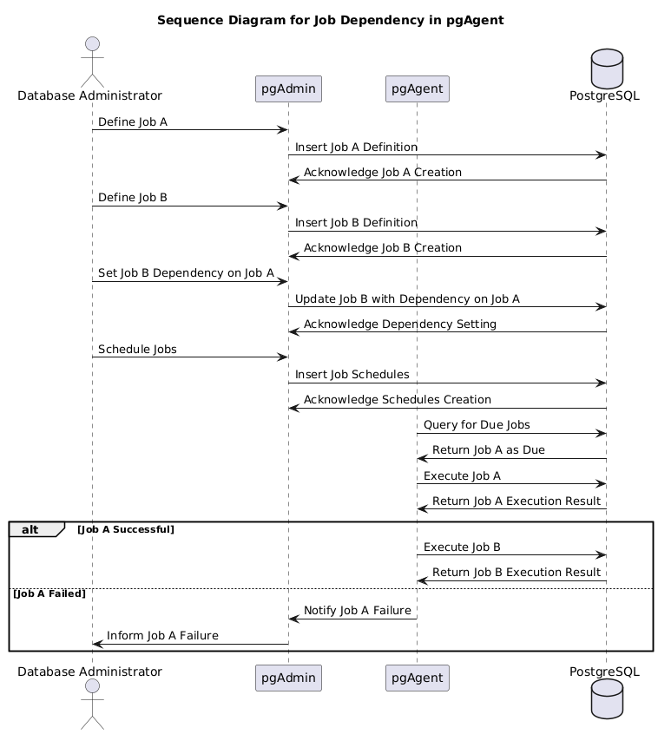
Visualization

Slide 8
Existing Problems In Role Based Access Control
Lack of Granularity : do not allow fine-grained control over permissions at the job or job group level.
eg: An administrator cannot restrict access to specific jobs or job parameters for a subset of users.
Overly Broad Permissions : Systems often grant excessive privileges to roles, increasing the risk of unauthorized access or accidental data modification.
eg: A role designed for job execution may also allow job editing, which is unnecessary.
Static Role Assignment : Roles are often assigned manually or statically, making it challenging to adapt to dynamic environments.

Slide 9
Existing Solutions/Approaches
Role Based Access Control:
MongoDB Access Control : MongoDB offers a robust RBAC system where users are assigned roles with specific privileges. Roles can be defined at the database or collection level, allowing fine-grained access control.
MySQL Role Management : MySQL allows roles to group privileges and manage user access. Role-based access control is used for managing permissions on databases, tables, or specific queries.

Slide 10
Functional Requirements
• FR-4: Define roles (Admin, Developer, Viewer) with specific permissions.
• FR-5: Enforce authentication for role assignment and job execution.
• FR-6: Restrict job editing and deletion based on roles.

Slide 11
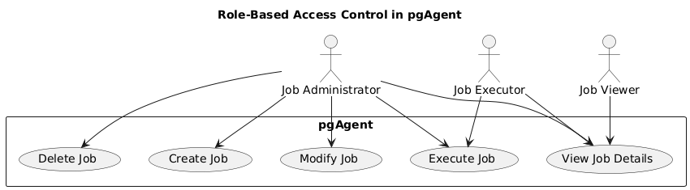
Visualization

Slide 12
Implementation Plan
Phase 1: Requirements Gathering and Analysis (Duration: 2 weeks)
Phase 2: Role-Based Access Control (Duration: 3 weeks)
Phase 3: Job-Dependency (Duration: 2 weeks)
Phase 4: System Testing and Optimization (Duration: 2 weeks)

Slide 13
Testing Objectives
• Verify job dependency execution workflows.
• Validate role-based access control for different user roles.
• Ensure system stability and performance under high job loads.

Slide 14
Testing Strategy
• Functional Testing: Ensure job dependencies (sequential, conditional, and parallel) and RBAC features work as intended.
• Performance Testing: Test the system's efficiency under heavy job scheduling and execution loads.
• Security Testing: Validate secure authentication mechanisms, role-based permissions, and data encryption for job details.
• Usability Testing: Ensure the pgAdmin UI for dependency visualization and role management is user-friendly.

Slide 15
Work Distribution
1)Role-Based Access Control(Critical Priority): Brian and Joel
2)Job Dependencies(High Priority): Brian and Joel

Slide 16
TIMELINE
Project Selection
First meeting with mentor
Installation of PostgreSQL and pgAgent
Creation of table as part of assigned task
Second meeting with mentor

Slide 17
THANK YOU

